Slide 1
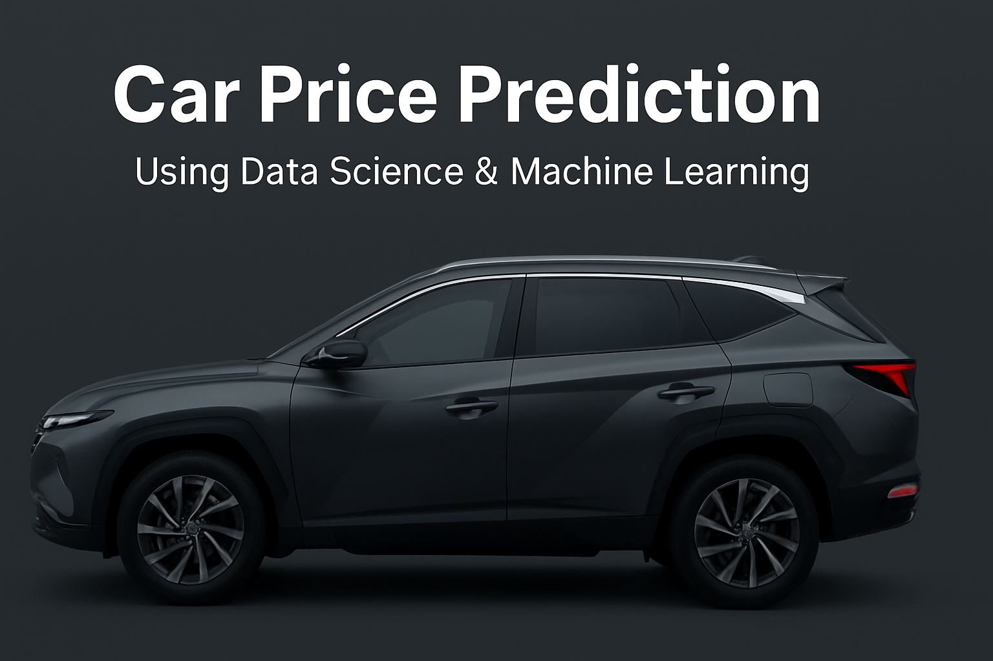

Slide 2
Introduction
• Importance of Data Science & ML in Automobile Industry
• Applications: Revenue Forecasting, Customer Loyalty, Machine Survival, Market Share Estimation

Slide 3
Problem Statement
Rapid increase in car sales & purchases during/post-COVID
Requirement: Estimate revenue of companies like Cars24, CarWale, Spinny
Predict margins & market share to evaluate survival in current market

Slide 4
Data Source
Data scraped from Cars24 website
Dataset includes car details (make, model, fuel, transmission, etc.)
Attributes: Year, City, Fuel Type, Transmission, Kilometers Driven, Ownership, etc.
In the Data, there are
Missing values: transmission 376, bodytype 375
Duplicates: 15

Slide 5
Data Preprocessing
Removed duplicates & null values.
Fixed negative discountprice.
Created age feature from year.
Converted categorical values into numerical (OneHotEncoding).
Mapped ownernumber to owner_category.

Slide 6
Exploratory Data Analysis (EDA)

Slide 7
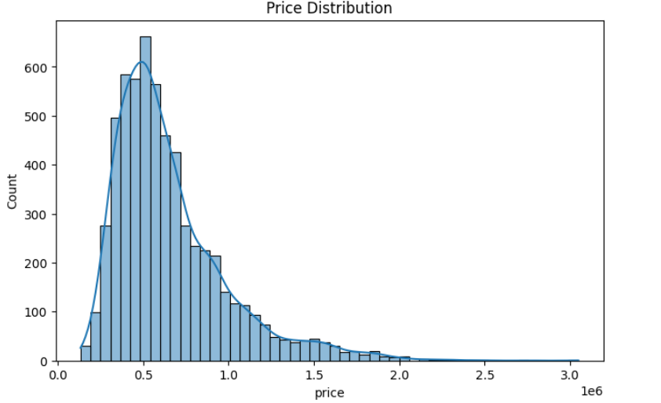

Slide 8
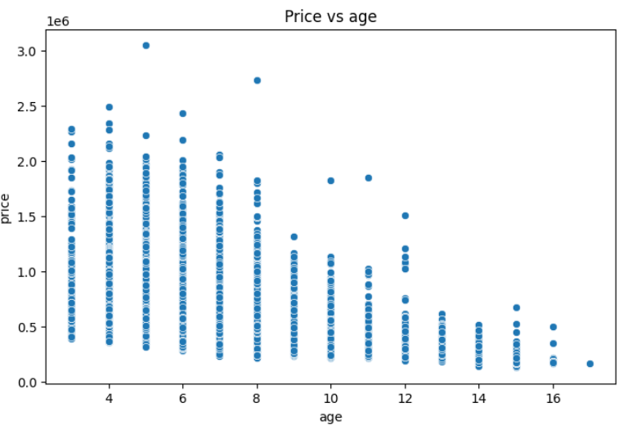

Slide 9
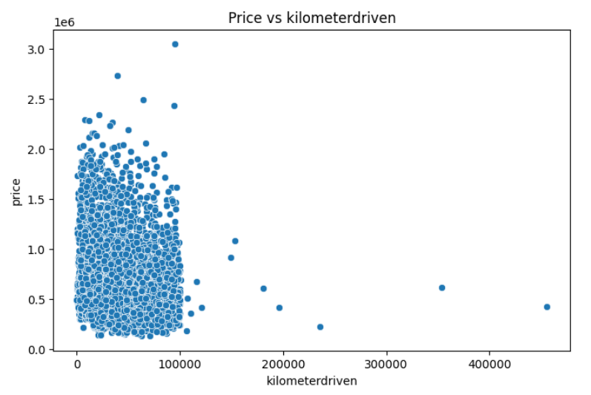

Slide 10
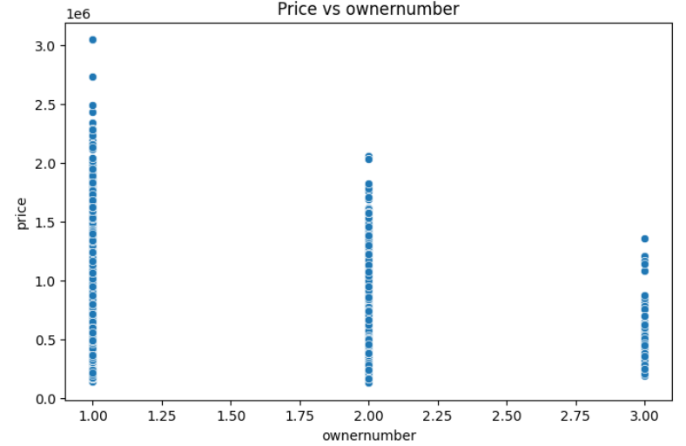

Slide 11
Model Building
Train/ Test split (80/20).
Pipeline:
Numeric: StandardScaler
Categorical: OneHotEncoder
Models tried: Linear Regression, Decision Trees, SVR, KNN, XGBoost.
Final Model Chosen: XGBoost Regressor.

Slide 12
Deployment
Built a Streamlit web app.
Inputs: Car details (make, model, year, kms, fuel, etc.)
Outputs: Predicted resale price (₹ formatted).
Features: Car background UI, clean layout.

Slide 13
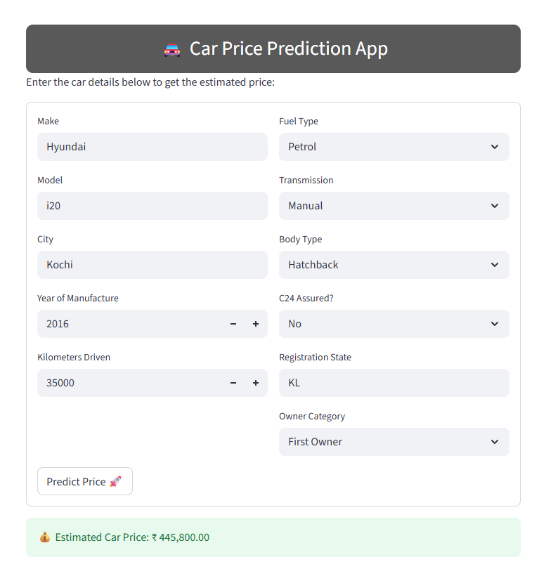

Slide 14
Conclusion
Accurate price prediction helps:
Sellers know fair resale value.
Buyers avoid overpriced cars.
Businesses (Cars24, Spinny, CarWale) improve margins.
Future work:
Add hybrid/electric price trends.
Integrate more city-level demand data.

Slide 15
Thank you

